Slide 1
CTFs – Not Just for Halo
Gamification of Information Security and Other Buzzwords
Ray Doyle
Clayton Dorsey
Notes:
Hook – question (ever done a CTF?)
Beginning – what are CTFs
Middle – how to do CTFs
Climax – WHY to do CTFs
End – thanks for coming, final thoughts
Intro, half of who we are slide (plus picture of me) – Ray
Half of who we are slide, what are CTFs, types of CTFs, CTF challenges, Demo #1 – Clayton
How to do CTFs, Advanced Tactics, Trello – Ray
Why, Why, Popular, Resources – Clayton
Demo, Q&A, (hints), End - Ray

Slide 2
Who are we?
Ray Doyle - @doylersec
https://www.doyler.net
Clayton Dorsey - @claytondorsey
Senior Penetration Tester at SecureWorks
Participated in various CTFs for over 10 years now
Team EverSec - 1st place SOHOpelessly Broken DefCon24, 2nd place DerbyCon 6, 7th place DefCon24 OpenCTF
DefCon24 Black Badge winner (SOHOpelessly Broken IoT Village CTF)
First time presenter
Soon to be Senior Penetration Tester at SecureWorks
CTFing since 2012
Competed in SOHOpelessly Broken since 2013, placed each year, won 1st twice
DefCon24 Black Badge winner (SOHOpelessly Broken IoT Village CTF)
First time presenter

Slide 3
Notes:
https://www.flickr.com/photos/wxs/with/480392249/

Slide 4
What are CTFs?
Capture the Flag (CTF) competitions are generally on information security topics with challenges, winners, and sometimes even prizes!
Often a series of challenges or computers to attack and defend
Team or individual based
Challenges to solve that usually give “flags” (ther5s_n0_Place_l1ke_h0m3)

Slide 5
Types of CTFs
Jeopardy
Attack-defense
Mixed/Scenario
Notes:
https://ctftime.org/ctf-wtf/
Jeopardy – various challenges and questions in a range of categories. Teams (or individual players) receive points for each task, generally relating to the difficulty of the question. At the end of the game, the points are tallied and the winner is the team with the most points. This is the most common format, especially in online-only CTFs.
Attack- defense - this type of CTF involves a network or host with vulnerable services. Teams are generally given time to patch and defend their hosts while developing exploits to use against other teams. After a specified amount of time, the network is opened up, and the attacks/defense can begin. (DefCon and CCDC are the most common attack-defense)
Mixed/Scenario - mixed format CTFs are either a combination of the above two types of CTFs or an entirely different format altogether. Scenario based CTFs are similar in style to Jeopardy, but without specific challenges or points specified. (UCSB iCTF is the main mixed CTF. DerbyCon and Eversec are scenario CTFs.

Slide 6
CTF Challenges
Cryptography
Steganography
Binary Exploitation
Reverse Engineering
Mobile challenges
Network challenges
Physical attacks
Forensics
Packet Analysis
Games
Obscure systems/languages
Programming
And more!

Slide 7
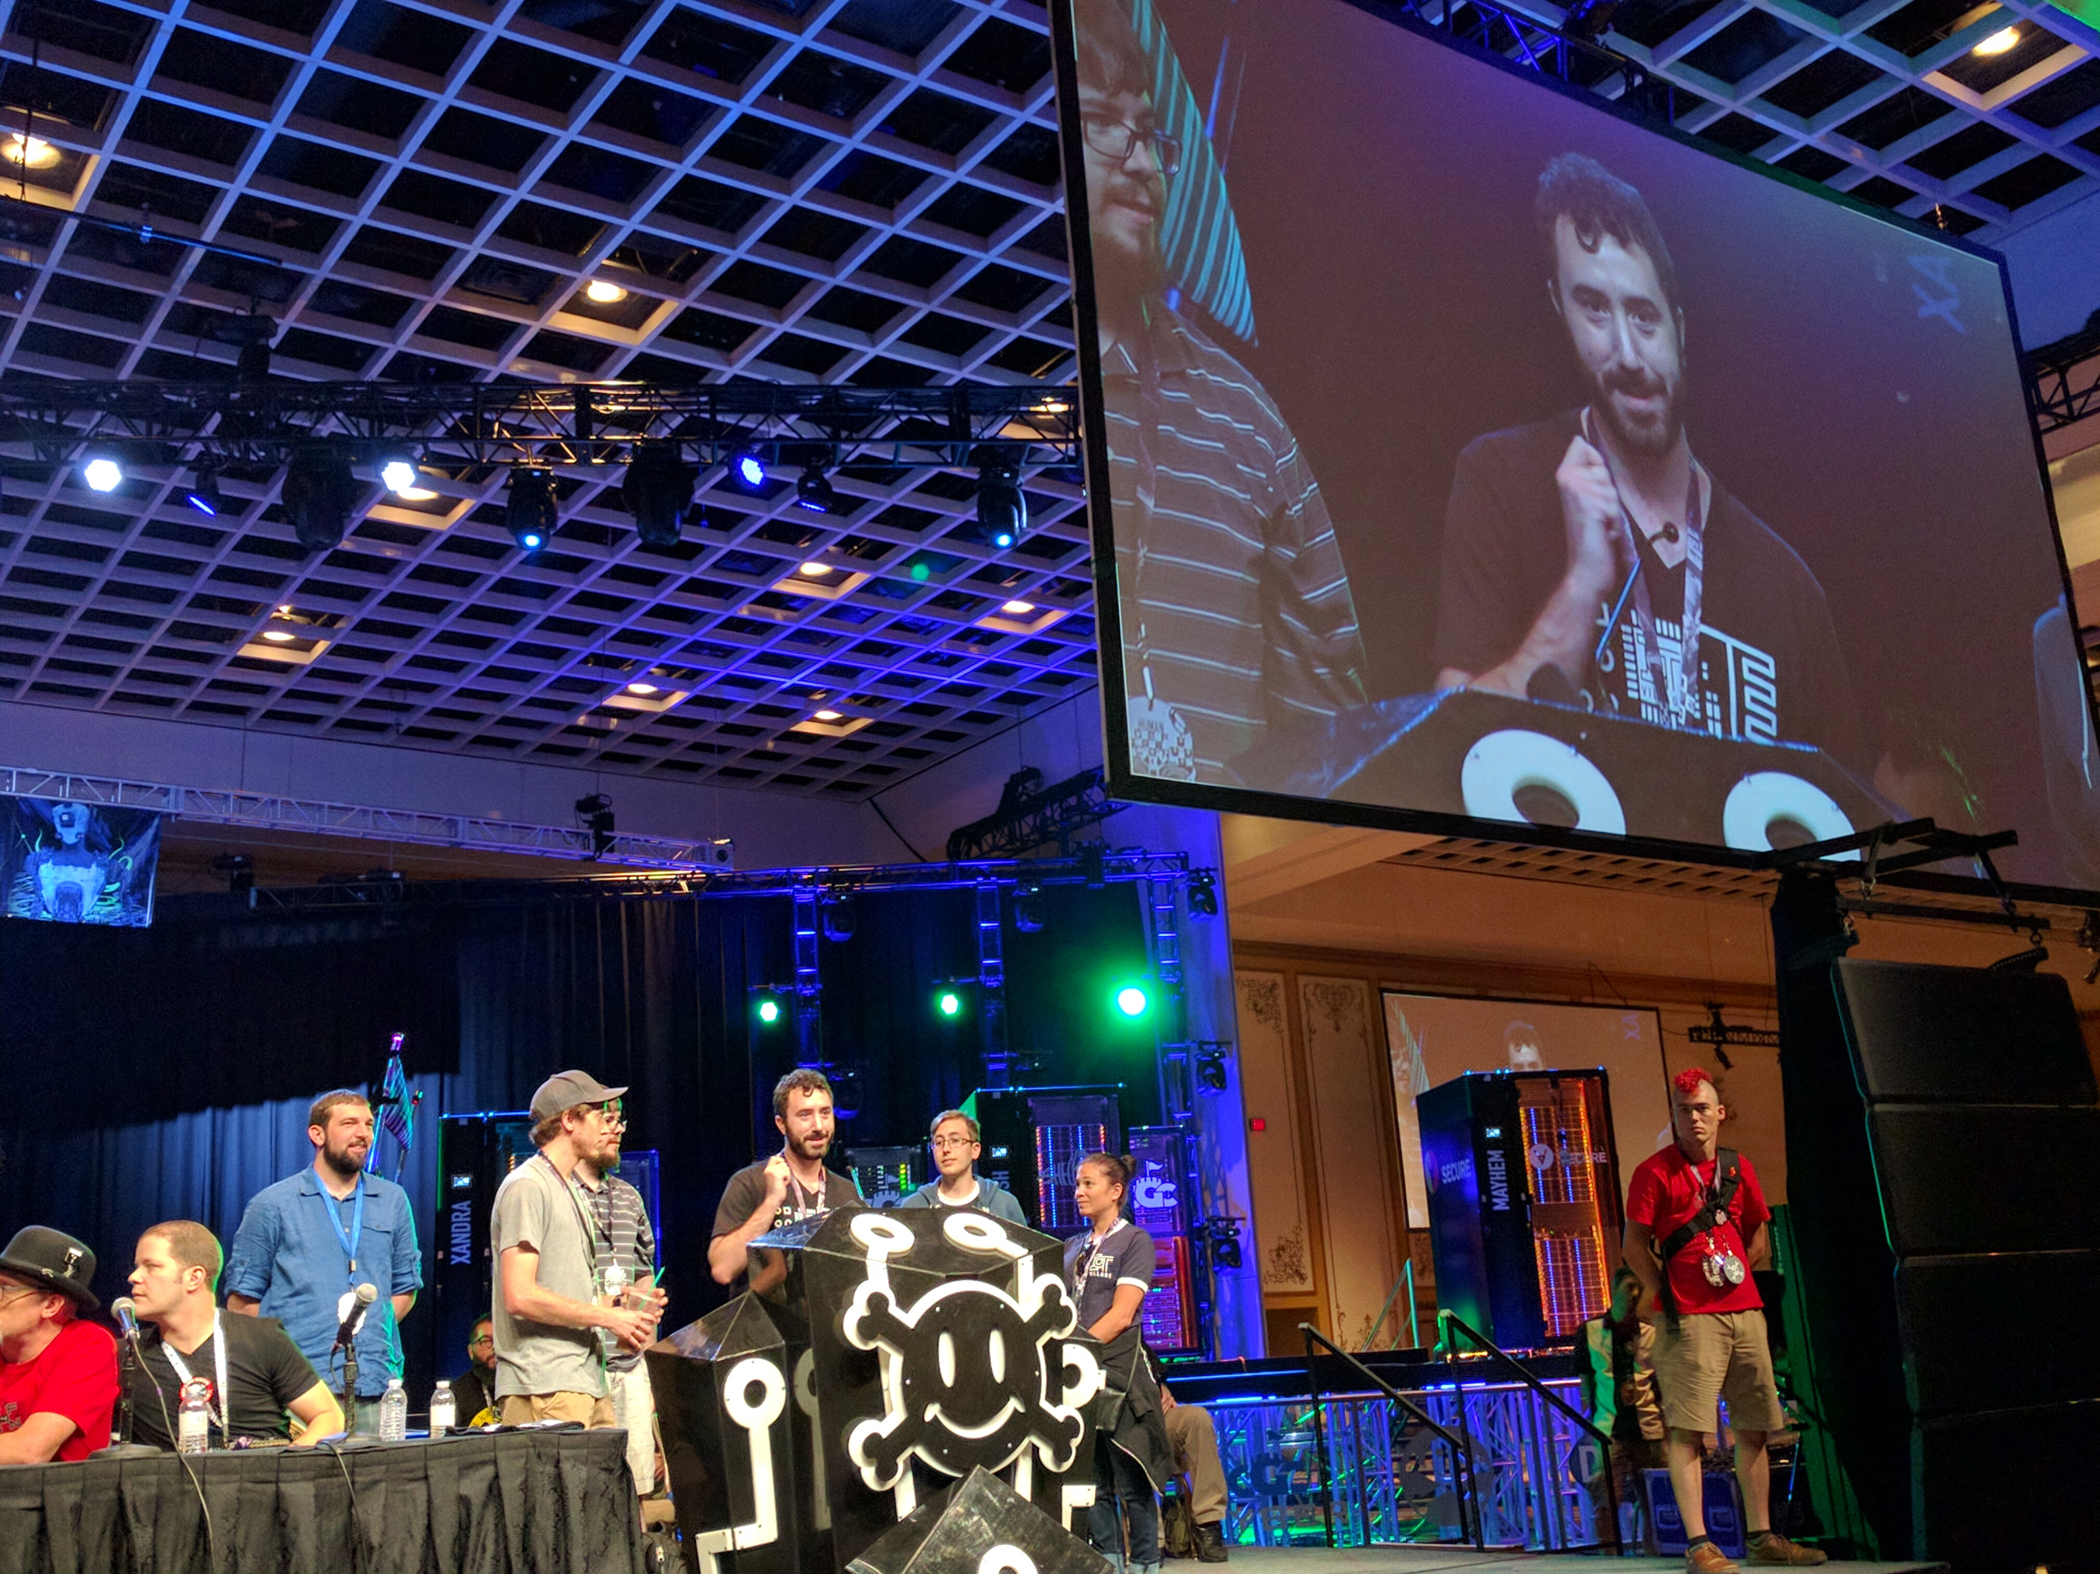
Demo 1

Slide 8
How to do CTFs
Just enter (CTFtime) or signup early
Join a random team (in person is easier)
/r/OpenToAllCTFteam
Read write-ups of older challenges, as well as challenges that you attempted (whether you completed them or not) - https://github.com/ctfs/
GOOGLE!
Notes:
http://www.openctf.com/html/firstctf.html

Slide 9
Advanced CTF Tactics
Slack
Trello
Specialization
Out-of-band tactics and resource gathering
Notes:
http://www.openctf.com/html/firstctf.html

Slide 10
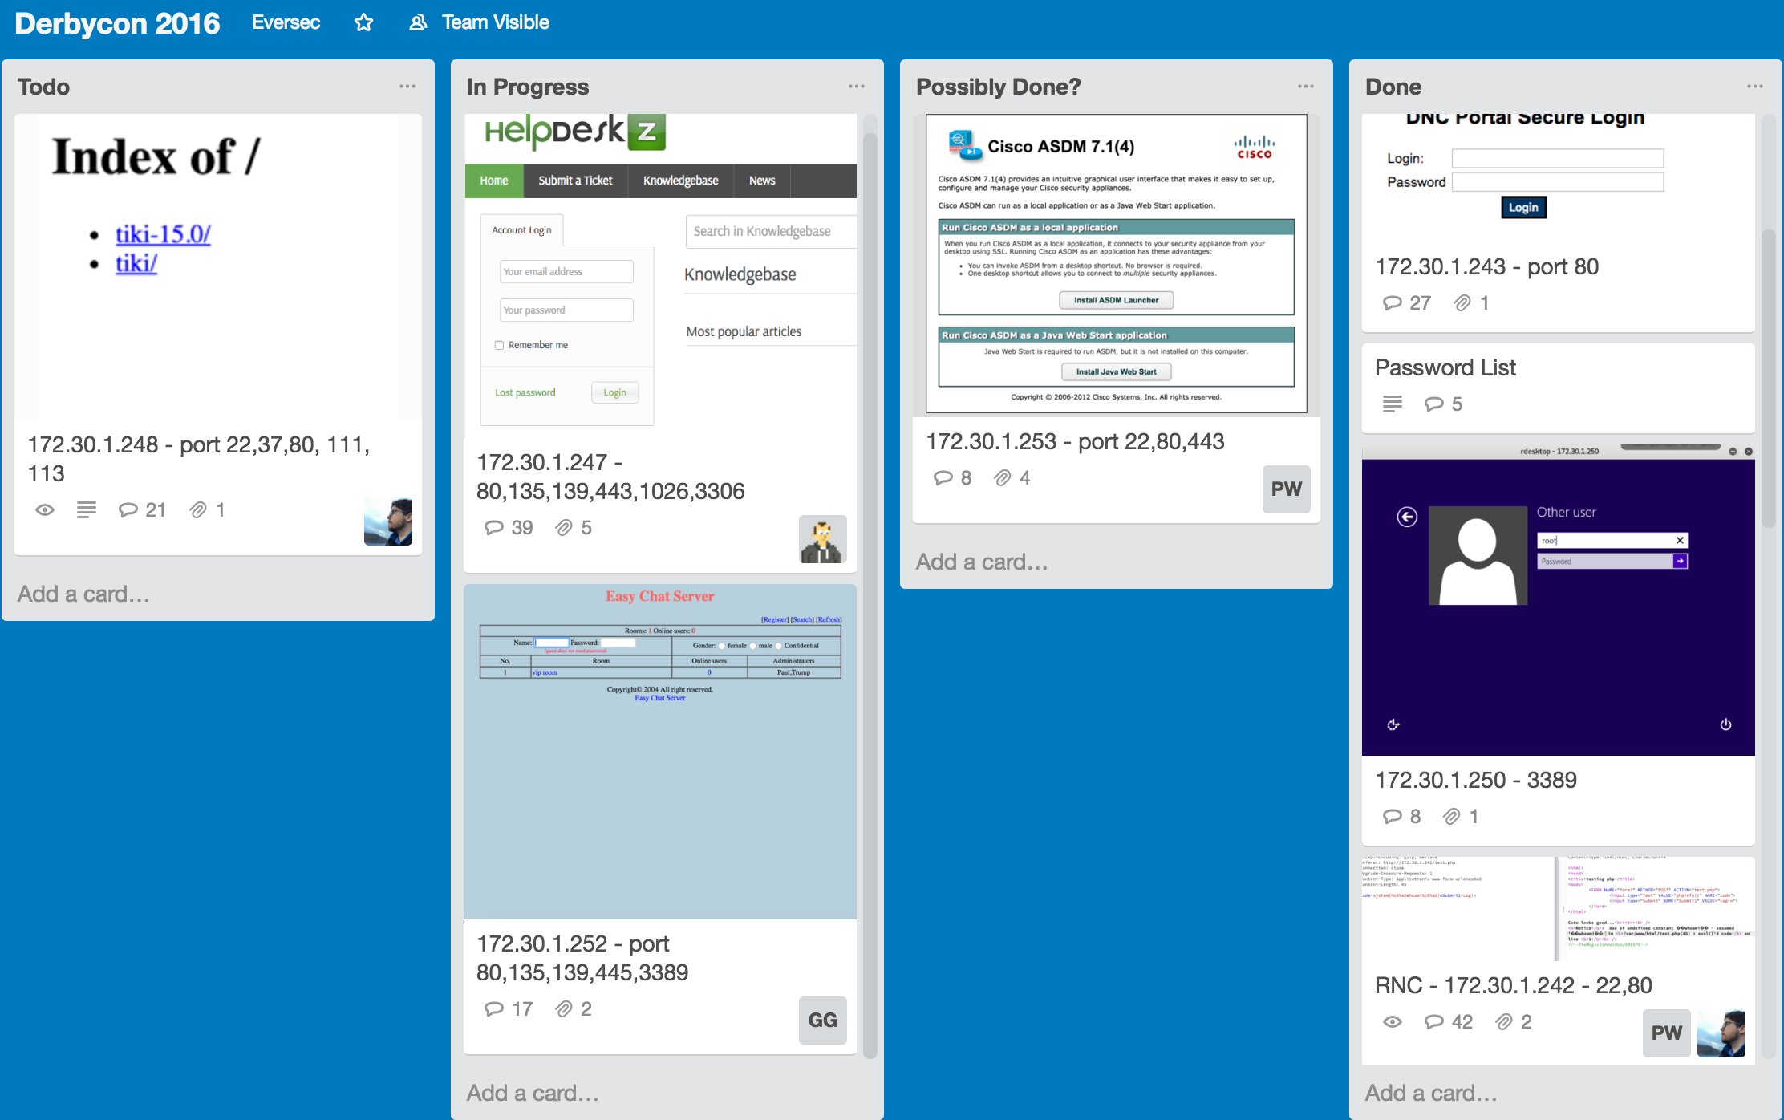
Trello
Notes:
http://www.openctf.com/html/firstctf.html

Slide 11
Why do CTFs?
Notes:
https://www.thesun.co.uk/wp-content/uploads/2016/07/nintchdbpict000255744918.jpg

Slide 12
Why do CTFs?
Closest thing to hacking / pentesting for many people
Gain experience with tools
Hone skills, learn new ones
Competition is fun, motivating, aggravating
Meet new people, potential employers or co-workers
CTFs as part of job interviews

Slide 13
Popular/Upcoming CTFs
DEFCON
DEFCON CTF - https://legitbs.net/
OpenCTF
IoT Village – SOHOpelessly Broken
Derbycon CTF
CSAW CTF (good for beginners)
Upcoming
PoliCTF - http://www.polictf.it/
Google CTF - http://g.co/ctf
EverSec CTF at CarolinaCon!

Slide 14
Resources
ctftime.org - Great for finding upcoming CTFs, challenge writeups, and scoring teams
github.com/zardus/ctf-tools - long list of tools separated by challenge category
Practice CTFs
picoCTF
Pwn Adventure – an MMO client and server you can run and hack to beat
Previous CTF writeups

Slide 15
Demo 2

Slide 16
Questions and Answers

Slide 17
END

